Slide 1

Design Process
Nitin Varade (UX Consultant)

Slide 2
What is Design?
Design is achieving goal with constraints
Systematic approach to find problem and provide an appropriate solution.
Goals: What is the purpose of design we are intending to produce? Who is it for? Why do they want it?
Constraint's: What materials must we use? What standards must we adopt? How much time do we have to develop it? Are there health and safety issues? Any technical constraint's?

Slide 3
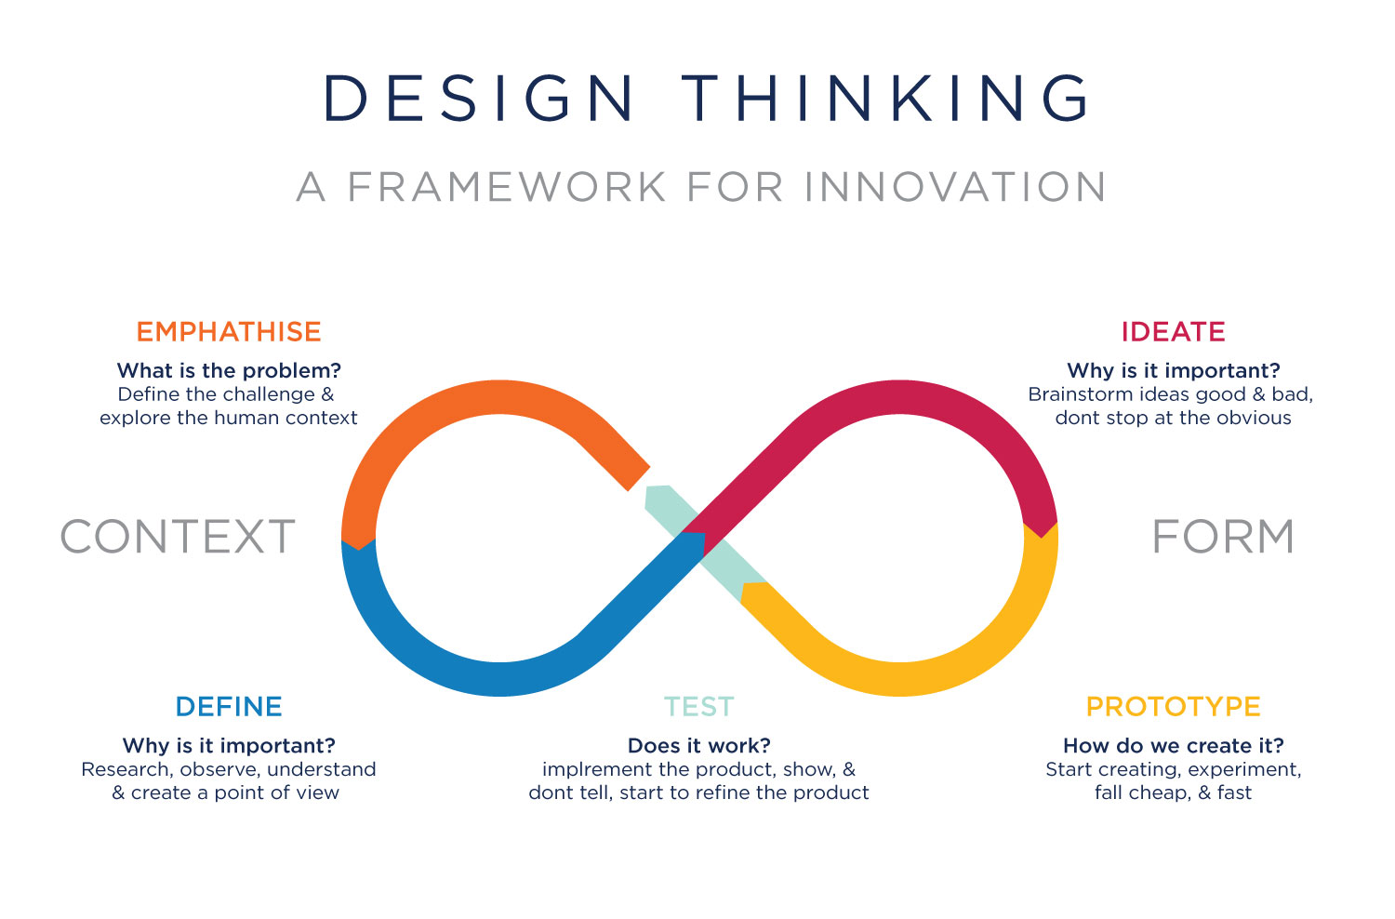
Interaction Design Process

Slide 4
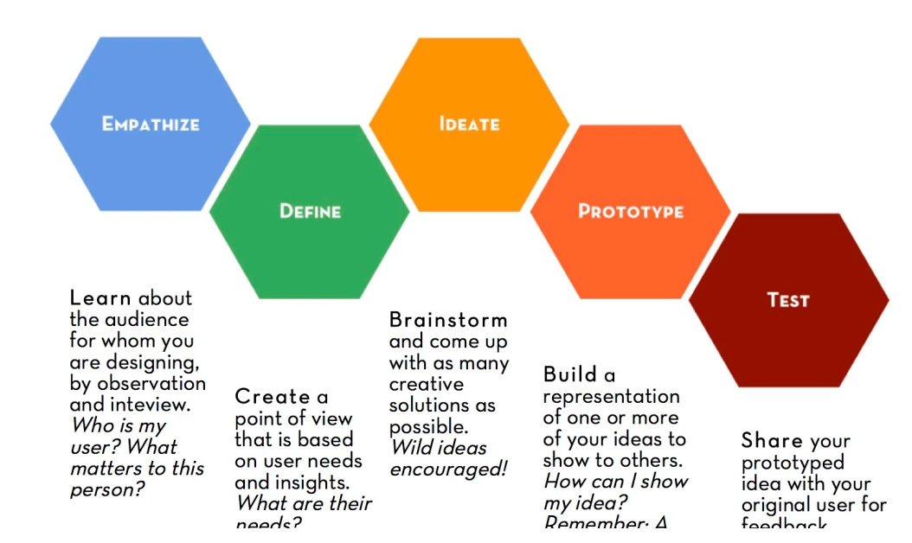
Why HCI Is Important?

Slide 5
Different types of Design
Business design.
Enterprise design.
Products design.
Execution design.
Interface Design.
Visual Design/Graphics Design
https://medium.com/@markymark/three-types-of-design-3623c3243aa6

Slide 6
Future of Interfaces
There are different concepts related to user interface design:
User interface design: User interface design (UI) or user interface engineering is the design of user interfaces for machines and software, such as computers, home appliances, mobile devices, and other electronic devices, with the focus on maximizing the user experience. The goal of user interface design is to make the user's interaction as simple and efficient as possible, in terms of accomplishing user goals (user-centered design).
Interaction design: In design, human–computer interaction, and software development, interaction design, often abbreviated IxD, is defined as "the practice of designing interactive digital products, environments, systems, and services." Like many other design fields interaction design also has an interest in form but its main focus is on behavior. What clearly marks interaction design as a design field as opposed to a science or engineering field is that it is synthesis and imagining things as they might be, more so than focusing on how things are.
User experience design: User Experience Design (UXD or UED or XD) is the process of enhancing user satisfaction by improving the usability, accessibility, and pleasure provided in the interaction between the user and the product. User experience design encompasses traditional human–computer interaction (HCI) design, and extends it by addressing all aspects of a product or service as perceived by users.

Slide 7
Future of Interfaces
There are different concepts related to user interface design:
User-centered design: User-centred design (UCD) is a framework of processes (not restricted to interfaces or technologies) in which the needs, wants, and limitations of end users of a product, service or process are given extensive attention at each stage of the design process. User-centred design can be characterized as a multi-stage problem solving process that not only requires designers to analyse and foresee how users are likely to use a product, but also to test the validity of their assumptions with regard to user behavior in real world tests with actual users at each stage of the process from requirements, concepts, pre-production models, mid production and post production creating a circle of proof back to and confirming or modifying the original requirements. Such testing is necessary as it is often very difficult for the designers of a product to understand intuitively what a first-time user of their design experiences, and what each user's learning curve may look like.

Slide 8
User Persona
Having users means you’re doing something right — people are engaging with your product.
Needless to say, it’s important to identify who’s on the other side of the relationship if you plan to keep it that way. Businesses who aren’t in touch with their users are often helpless in understanding how they think and make decisions that affect purchasing power.
At the same time, a business that simply takes a guess at who their audience is or what they want may be completely off base — losing sales and customers as a result.
This is where creating user personas helps businesses better understand and reach their target audience. Of course, this is easier said than done, so we’ve put together this guide to help you craft user personas that actually move the needle.

Slide 9
What is User Persona?
What is a User Persona?
User personas are semi-fictitious representations of your target customers. A user persona is framed from real customer discovery and researching the needs, goals, and observed behavioral patterns of a target audience.
User personas help you get inside the mind of your audience. They allow you to gain valuable insights and make decisions based on your users’ needs.

Slide 10
How Many User Personas Do You Need?
It’s rare that a business only targets one audience. Chances are if you’re building your online presence, you’ll be trying to target a range of audiences. In this case, one user persona isn’t going to cut it — leaving you to decide how many you should actually create.
At first, a couple dozen user personas might seem like a good idea. But you’ll realize that the more you create, the more they begin to resemble one another.
We suggest creating no more than four user personas.
Most brands have audiences with characteristics that fall under a subset of primary personas. Having any more just makes user personas unnecessarily complicated and can lead to a lack of focus and a jumbled creation process. Because the goal of user personas is to gain insight into the bulk of your audience, four is more than enough.

Slide 11
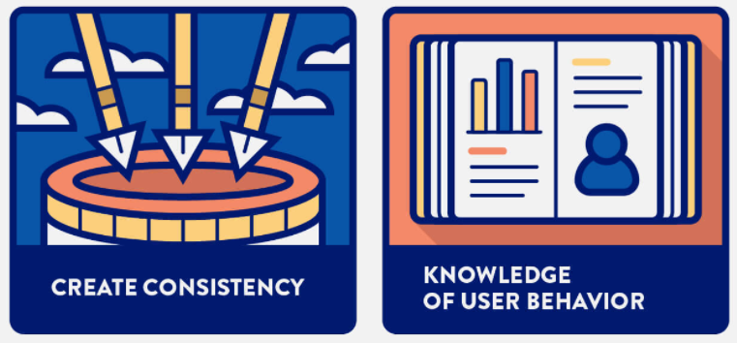
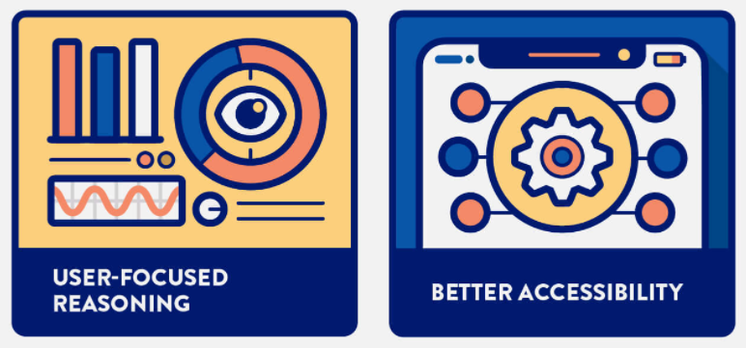
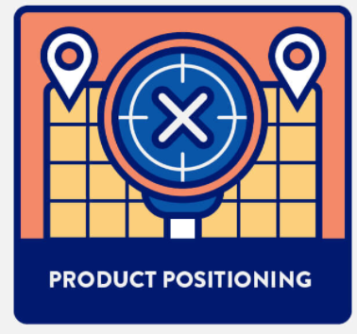
How User Personas Benefit Business
User personas are extremely useful to grow and improve a business. They help uncover the different ways people search for, buy, and use products, so you can focus your efforts on improving the experience for real people through real data.
User personas benefit a business in several ways:

Slide 12
How User Personas Benefit Business
Create consistency across the business: User personas offer a company-wide understanding of your users, putting everyone on the same page. Across the board, personas create a consistent and specific understanding of each target group of customers within your company.
Signal user behavior: By gaining insight into the backgrounds of user personas, you’ll have a better understanding of where your real users spend their time, where they obtain information, and which social networks they thrive in. This information allows you to target and promote your products or services in places where they will actually be seen.
Help with user-focused reasoning: So, you and your team have brainstormed a service or offer that you think will be valuable to your users, but is it really something that they want? You might think your idea is genius, but what if you spend time brainstorming and it’s not something that’s actually in demand? User personas help eliminate wasted time and resources by clearly focusing on the needs of the user.
Improve design and development workflow: Not only do personas allow you to gain knowledge of user behavior and create consistency across your business, but they’re incredibly valuable in enabling design and product managers to create better products, services, designs, and UX. Better development guarantees your ability to suit the needs and preferences of your real users.
Define product positioning: Because you’ve utilized user personas in the brainstorm and developmental phases, you’ll be in a better place to position your product when it comes to promotion. User personas arm you with research to face the challenges and problems that come with product positioning.

Slide 13
Any Questions?
Nitin Varade
Tech Manager (UX Professional) @ Tech Mahindra
https://www.linkedin.com/in/nitinvarade/
M: 9011015213
Notes:
In Slide Show mode, select the arrows to visit links.

